Slide 1
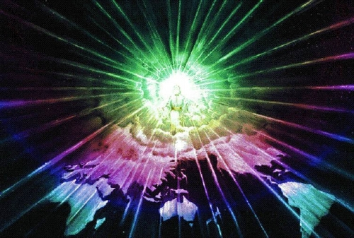
God’s Crazy Prophetic Warnings

Slide 3
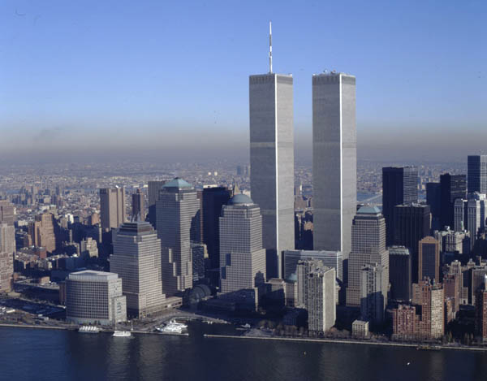

Slide 4
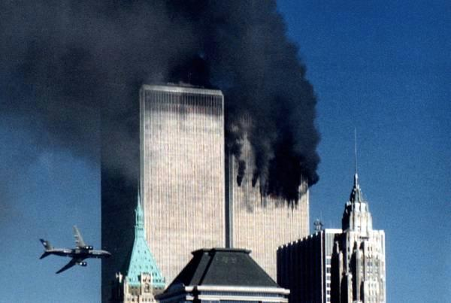

Slide 5
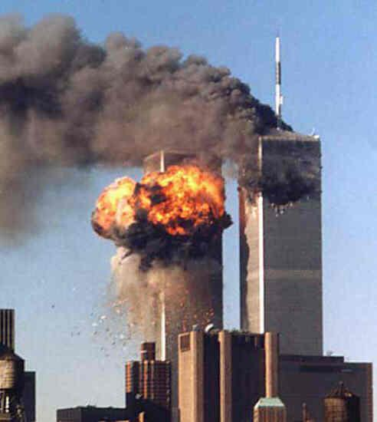

Slide 6
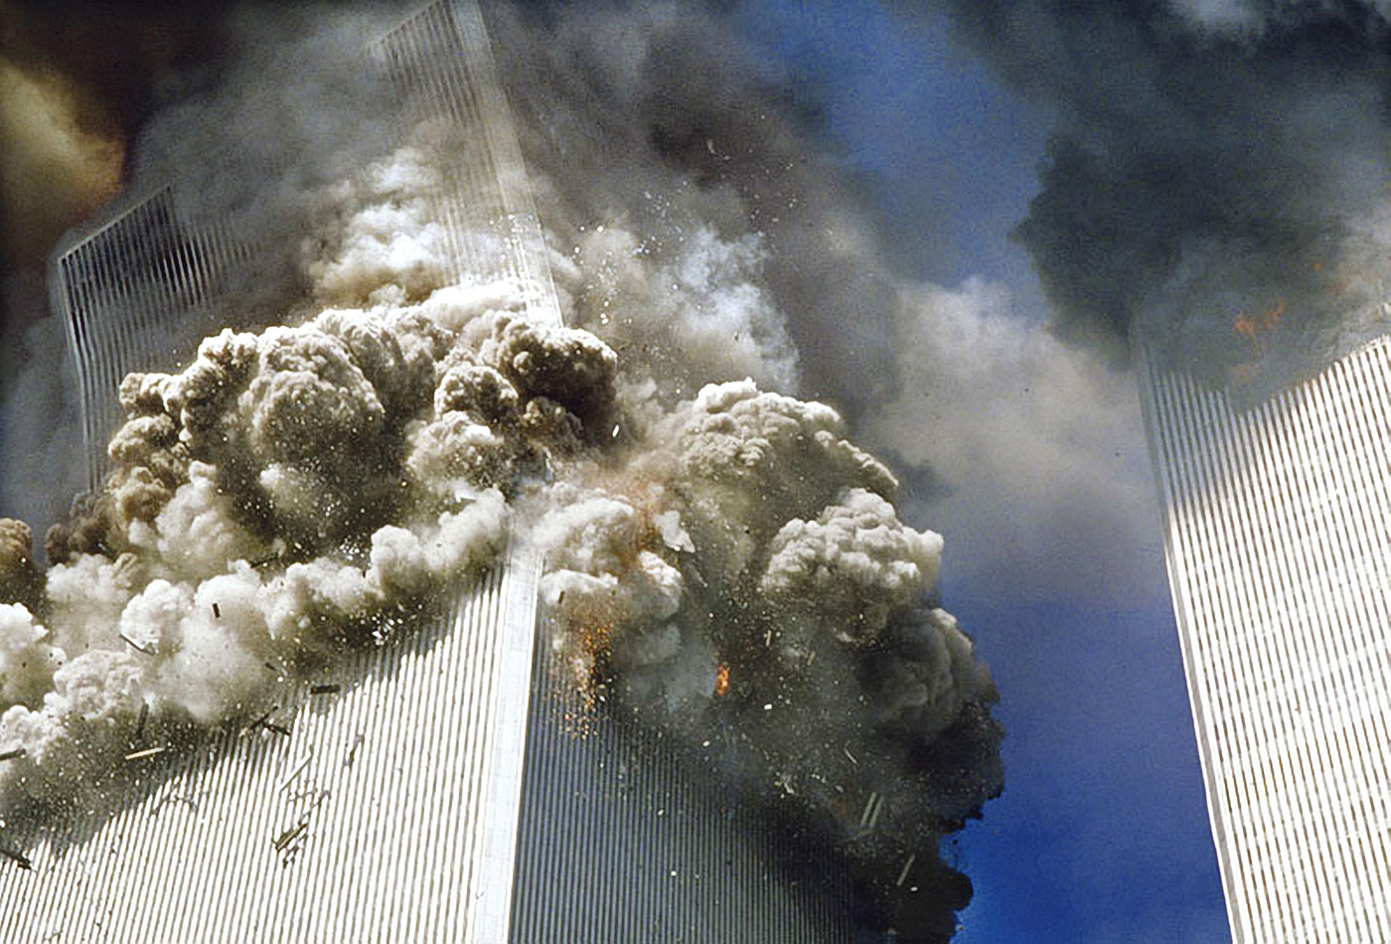

Slide 7
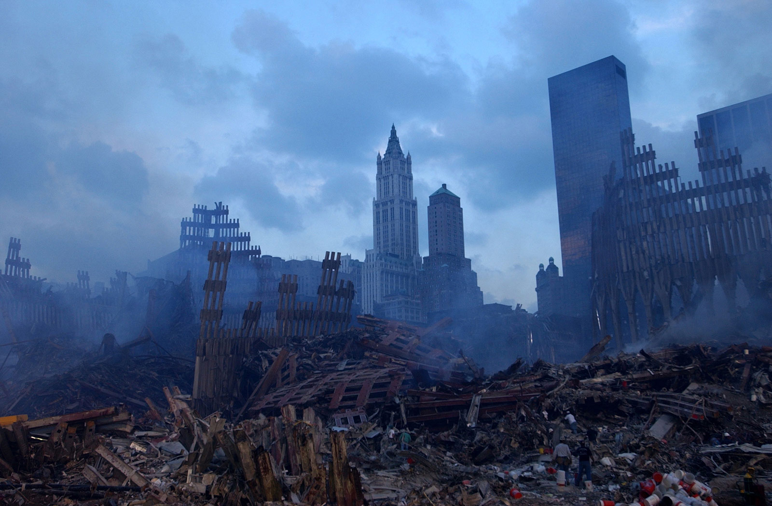

Slide 8
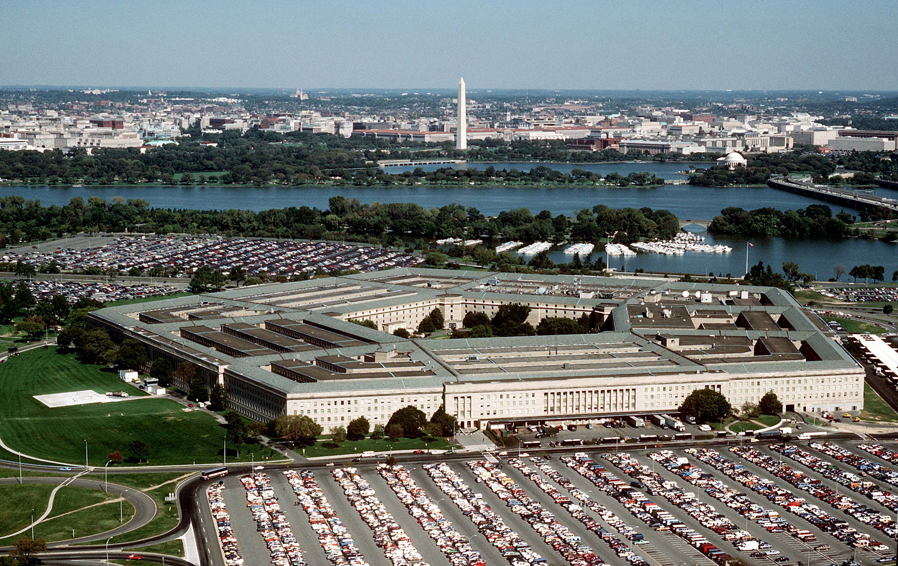

Slide 9
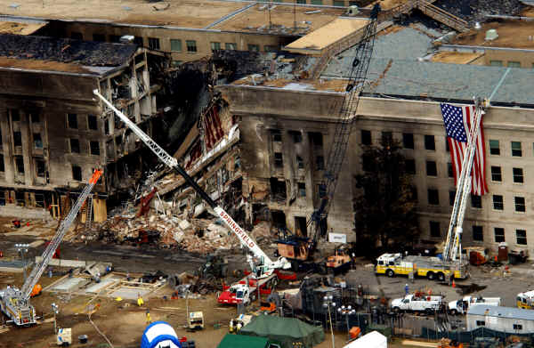

Slide 10
Harbinger: One that indicates or foreshadows what is to come…
Isaiah 9:10 – The bricks have fallen, but we will build with dressed stones; the sycamores have been cut down, but we will put cedars in their place.

Slide 11
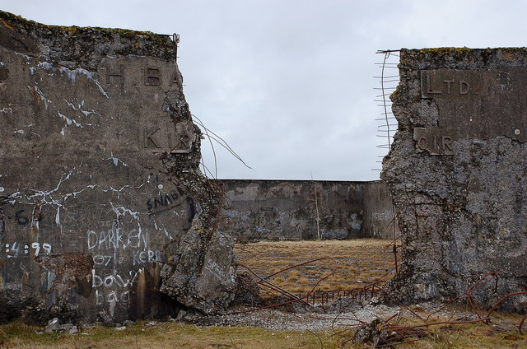
The First Harbinger – The Breach

Slide 12
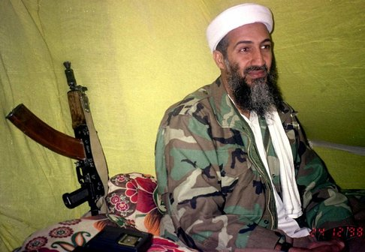
The Second Harbinger – The Terrorist

Slide 13
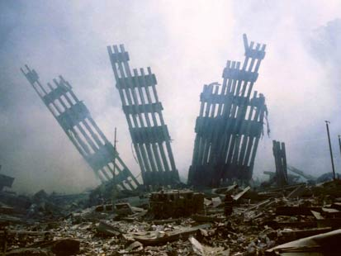
The Third Harbinger – The Fallen Bricks

Slide 14
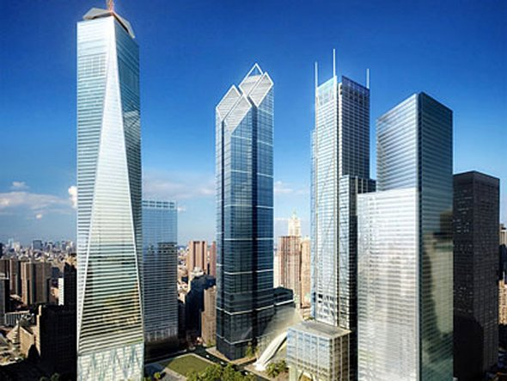
The Fourth Harbinger – The Tower

Slide 15
The Fourth Harbinger – The Tower
Senator John Kerry: “I believe one of the first things we should commit to—with federal help that underscores our nation’s purpose—is to rebuild the towers of the World Trade Center and show the world we are not afraid—WE ARE DEFIANT.”
- September 12, 2001

Slide 16
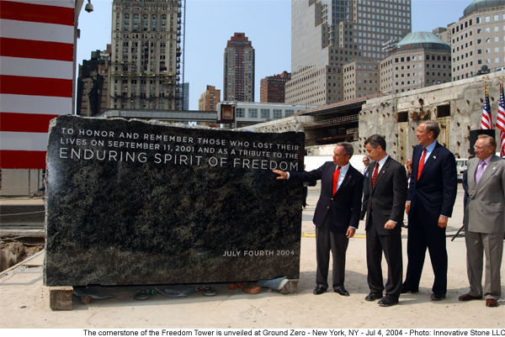
The Fifth Harbinger – The Gazit Stone

Slide 17
The Fifth Harbinger – The Gazit Stone
Governor Pataki: “Today we take twenty tons of Adirondack granite, the bedrock of our state, and place it as the foundation, the bedrock of a new symbol of American strength and confidence… Today, we, the heirs of that revolutionary spirit of defiance, lay this cornerstone…”
- July 4, 2004

Slide 18
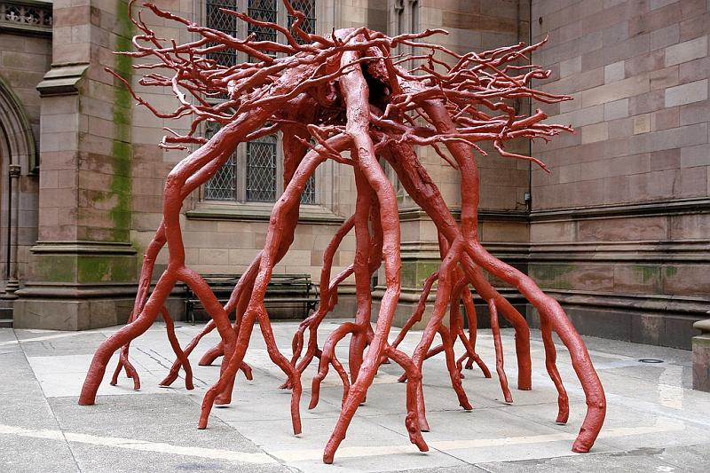
The Sixth Harbinger – The Sycamore

Slide 19
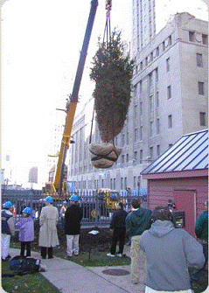
The Seventh Harbinger – The Erez Tree

Slide 20
The Eighth Harbinger – The Utterance
Isaiah 9:10 – The bricks have fallen, but we will build with dressed stones; the sycamores have been cut down, but we will put cedars in their place.

Slide 21
The Eighth Harbinger – The Utterance
Senator John Edwards
September 11, 2004
Isaiah 9:10 – The bricks have fallen, but we will build with dressed stones; the sycamores have been cut down, but we will put cedars in their place.

Slide 22
The Ninth Harbinger – The Prophecy
Isaiah 9:10 – The bricks have fallen, but we will build with dressed stones; the sycamores have been cut down, but we will put cedars in their place.

Slide 23
The Ninth Harbinger – The Prophecy
Senate Majority Leader Tom Daschle
September 12, 2001
Isaiah 9:10 – The bricks have fallen, but we will build with dressed stones; the sycamores have been cut down, but we will put cedars in their place.

Slide 24
The Forgotten Sabbath Years
Sabbath Year in Hebrew = Shemitah
The Shemitah happened every seven years on the Jewish calendar.
No agricultural work was to be done in this year. Debts were also to be remitted.

Slide 25
The Judgment of the Shemitah
2Chronicles 36:20-21 – He took into exile in Babylon those who had escaped from the sword, and they became servants to him… until the land had enjoyed its Sabbaths. All the days that it lay desolate it kept Sabbath, to fulfill seventy years.

Slide 26
Economic “Rebuilding”
Interest rates before Sept 11, 2001: 3.5%
Interest rates after Dec 11, 2001: 1.75%
Interest rates after June 2003: 1%

Slide 27
Economic “Rebuilding” Effects
Extremely low rates = easy loans, easy borrowing, easy mortgages = housing boom and building boom = mushroom of debt
Fannie May – Federal National Mortgage Association
Freddie Mac – Federal Home Loan Mortgage Corporation

Slide 28
Economic Collapse of September, 2008
Fannie May, Freddie Mac = September 7, 2008
Lehman Brothers collapse = September 11, 2008
Fannie May, Freddie Mac, Lehman Brothers were all bailed out with the release of debt of over $5,000,000,000,000

Slide 29
The Judgment of the Shemitah
Deuteronomy 15:1-2 – At the end of every seven years you shall grant a release. And this is the manner of the release: every creditor shall release what he has lent to his neighbor. He shall not exact it of his neighbor, his brother, because the Lord’s release has been proclaimed.

Slide 30
The Judgment of the Shemitah
Sabbath Year 5768: September 13, 2007 – September 29, 2008

Slide 31
The Judgment of the Shemitah
Sabbath Year 5768: September 13, 2007 – September 29, 2008
Greatest stock market crash ever:
September 29, 2008

Slide 32
The Crash of September 29, 2008
$700,000,000 bailout plan rejected by Congress

Slide 33
The Crash of September 29, 2008
$700,000,000 bailout plan rejected by Congress
7% of the stock market wiped away

Slide 34
The Crash of September 29, 2008
$700,000,000 bailout plan rejected by Congress
7% of the stock market wiped away
777 points drop in the stock market

Slide 35
The Previous Shemitah
Sabbath Year 5761: September 30, 2000 – September 17, 2001

Slide 36
The Previous Shemitah
Sabbath Year 5761: September 30, 2000 – September 17, 2001
Greatest stock market crash ever up to that point: September 17, 2001

Slide 37
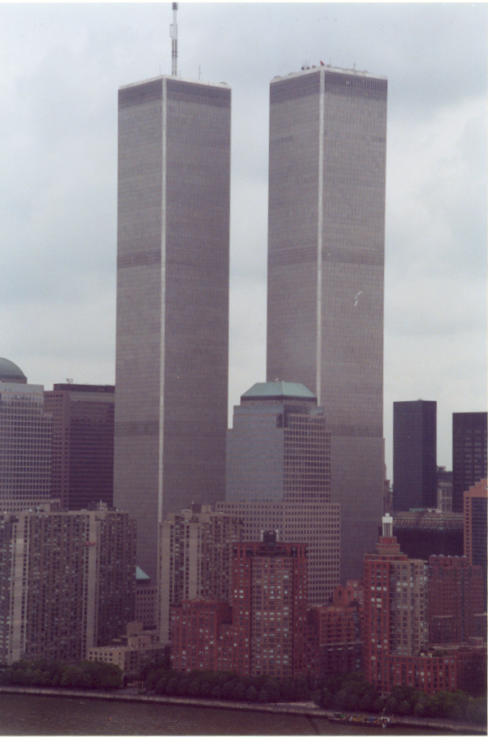
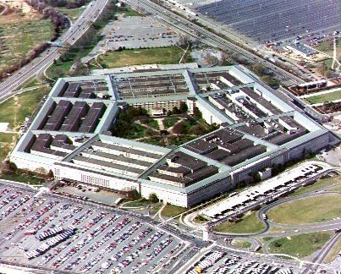
Lesson from the Symbols of America…

Slide 38
Lesson from the Symbols of America…
Everything of the world that you put your trust in over God will face judgment… God cannot bless idolatry. Stop trusting in man’s ways.

Slide 39
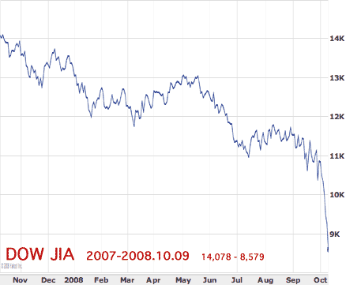
Lesson from the Sabbath Years

Slide 40
Lesson from the Sabbath Years
God has everything under control.

